Slide 1
Rheumatoid Arthritis
Outline of my research strategy
Identifying the RA cohort based on ICD-10 codes (2 major clinical chapters of RA exist in the literature)
Identifying the All Payer Claims Data APCD from a state that is very similar to MA in terms of incidence and prevalence of RA (I chose state of Vermont)
Choosing OP outpatient file to identify the RA cohort
Linking the RA patients to Revenue Code file using the Unique ID for each patient
Cross tabulation of the cohort by gender, age, insurance type, other variables...
Cross tabulation by services from Revenue Codes in order to identify the pathways
Matching/comparing the observed pathways from the APCD with the guideline recommended by the RA Society (guideline of 2015 attached)

Slide 2
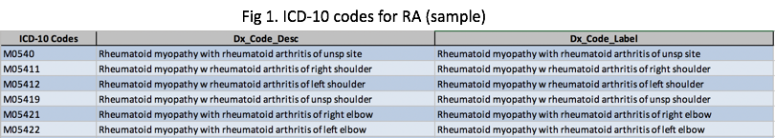
Rheumatoid Arthritis Cohort
I identified the Rheumatoid Arthritis cohort based on ICD-10 codes.
There are 2 major clinical chapters for RA (shown in excel file), rheumatoid arthritis and other rheumatoid with systemic involvement.
In total, there are 330 ICD codes for diagnosis, a few examples below.

Slide 3
Outpatient and Revenue data of 2016 Vermont All Payer Claims Data APCD
I used outpatient data of 2016 Vermont All Payer Claim Data and referred to 2015 American College of Rheumatology Guideline for the Treatment of Rheumatoid Arthritis for research.
For further evaluation of service utilization for RA (as a quick proxy for pathway), I linked outpatient file and revenue code file using unique ID for each patient.
Vermont and Massachusetts have similar geographic and weather conditions, both in northeast and known for cold and snowy weather in long winter. I chose the Vermont All Payer Claim Data because it is publicly available. Method should be the same/similar for Mass APCD.
RA is a chronic condition and thus I focused on the outpatient data to identify my cohort.

Slide 4
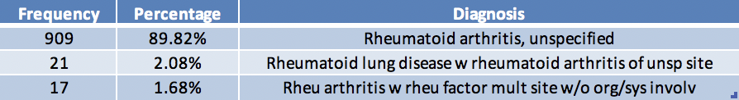
RA cohort in Vermont 2016
There are 100,2 patients OP encounters by the RA cohort. (VT APCD does not identify distinct pts for privacy)
Three main sub-cohorts based on the frequency of RA ICD-codes in diagnosis are:
Fig 2. Sub-cohorts of RA

Slide 5
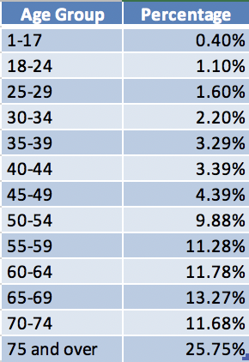

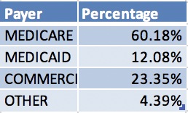
X-tabulation by age
X-tabulation by gender
X-tabulation by payer (insurance type)
Some early findings:
Age/Gender pattern: RA more common in seniors older than 50 and in female
RA pts mainly covered by Medicare.

Slide 6
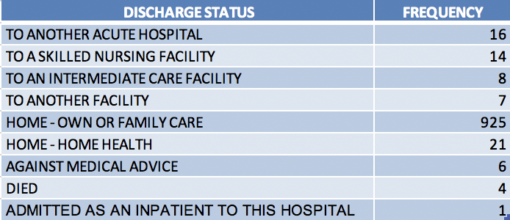
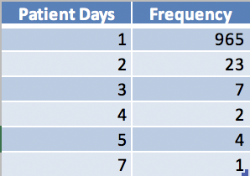
Treatment and Utilization
X tabulation by discharge status
X tabulation by LOS
Like most of the chronic conditions patients, most RA patients went back home on the same day they went to the OP facility

Slide 7
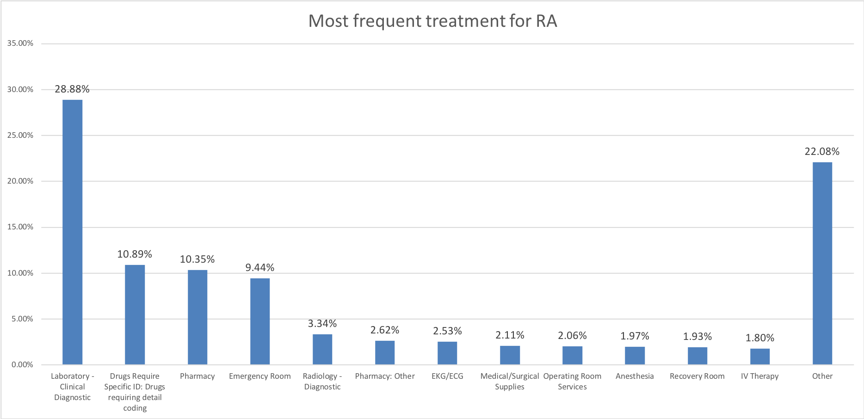
My early findings: Treatment and Utilization
Most frequent treatment in my VT APCD cohort according to Revenue Codes (Frequency more than 200 times)
Recommended care* for RA includes both pharmacologic and non-pharmacologic therapies.
Suggested Medication-based treatment includes nonsteroidal anti-inflammatory drugs (NSAIDs), non-biologic and biologic disease-modifying antirheumatic drugs (DMARDs) and so on.
*: 2015 American College of Rheumatology Guideline for the Treatment of Rheumatoid Arthritis for research

Slide 8
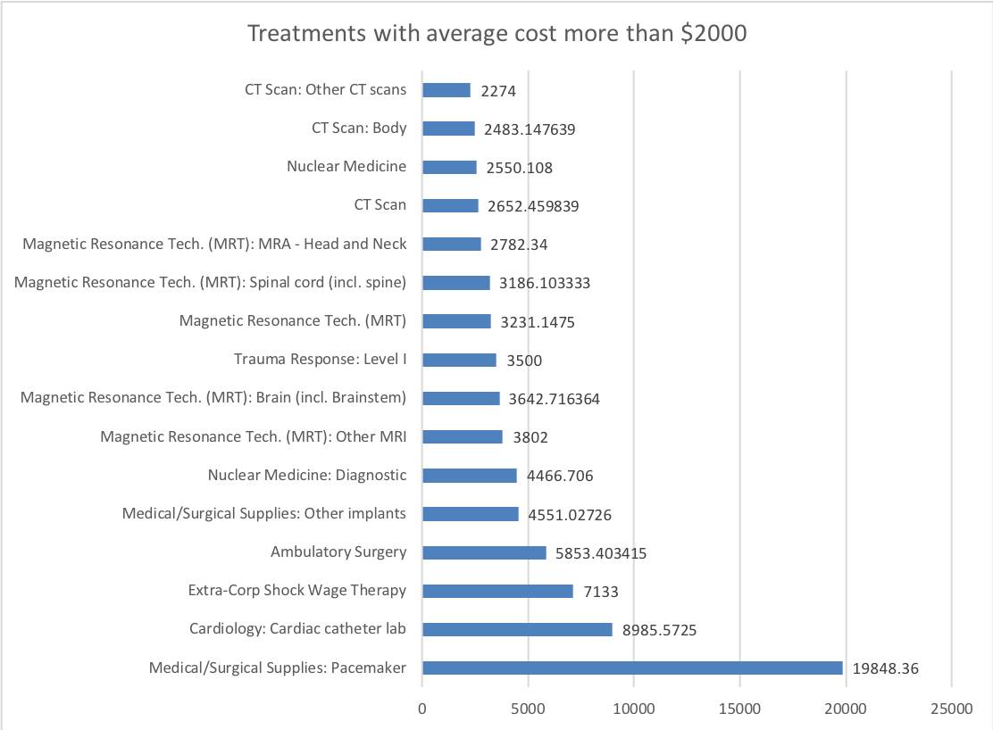
Treatment and Utilization
treatment patterns for the higher end of the cost distribution (high cost patients)
Most costly treatments are heart disease treatment and diagnostic treatment (Nuclear, MRI, MRT and CT).
For RA patients, cardiovascular disease CVD is a common comorbidity.

